Slide 1

OS Lab
Scheduling Algorithms-I
Instructor
Saba Naseem
saba.naseem@nu.edu.pk
4/30/2020
1

Slide 2
CPU Scheduling
Turn Around Time -Time Difference between completion time and arrival time.
Turn Around Time = Completion Time – Arrival Time
Waiting Time - time Difference between turn around time and burst time.
Waiting Time = Turn Around Time – Burst Time
Response Time - Amount of time it takes from when a request was submitted until the first response is produced

Slide 3
CPU Scheduling Algorithms
FCFS Scheduling
SJF (preemptive and/or non-preemptive) Scheduling
Round Robin Scheduling
Priority Scheduling (Priority is assigned for each process. Process with highest priority is executed first and so on.) preemptive and/or non-preemptive
Multilevel Queue Scheduling
Multilevel Feedback Queue Scheduling

Slide 4
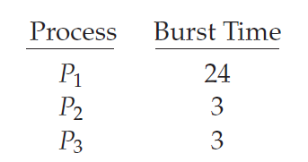
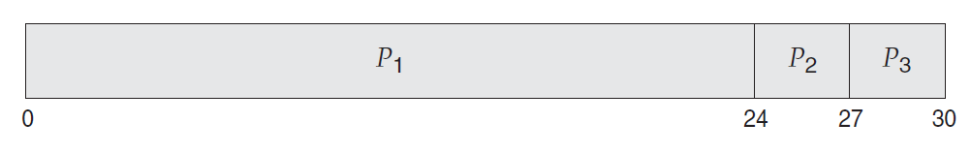
FCFS Scheduling

Slide 5
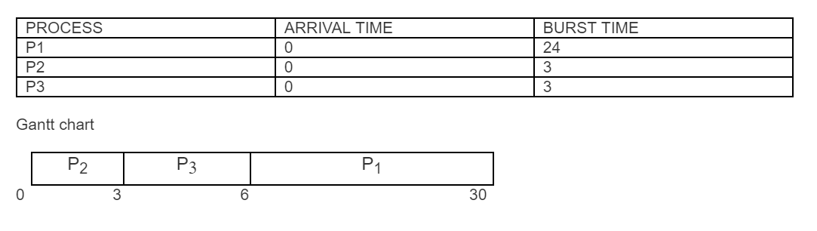
SJF NON PREEMPTIVE

Slide 6
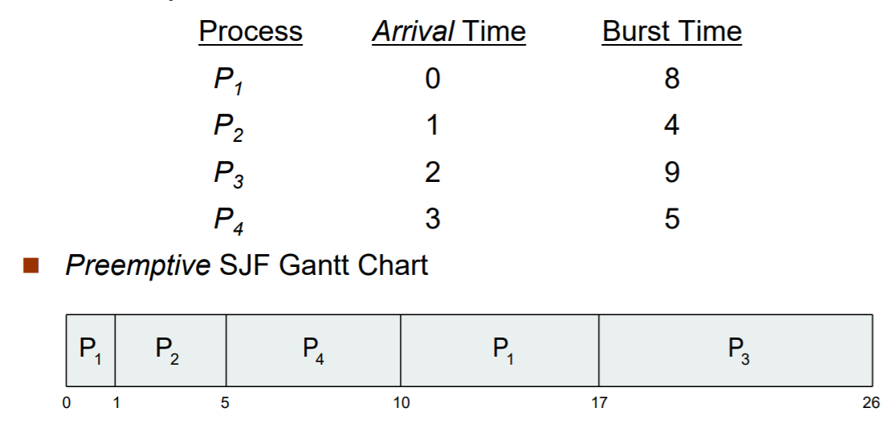
SJF PREEMPTIVE

